Slide 1
Detecting Credit Card Fraud
DS 4635 Final Presentation
By Jeffrey Chan, Adina Palayoor, Ethan Rudometkin, Taya Yakovenko, Nathan Willemsen

Slide 2
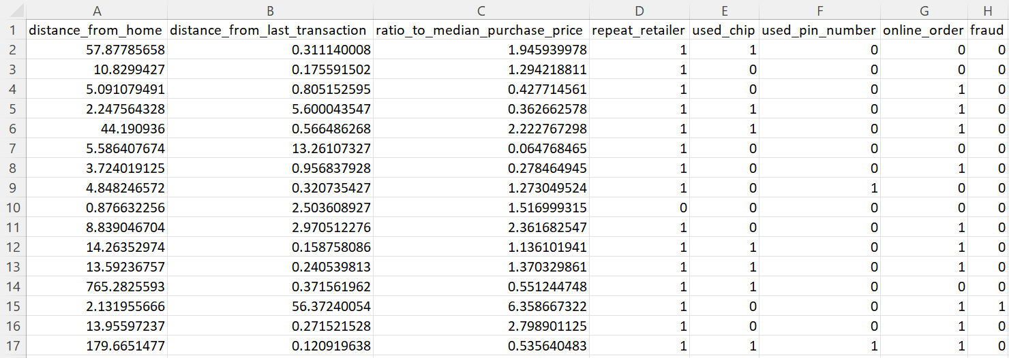
Data Description

Slide 3
Questions
Can we determine the input features that are affecting our overall accuracy the most?
How do we limit the number of times that we are not predicting fraud when we should be?
How do we determine the best classification model to predict credit card fraud?

Slide 4
Data Preprocessing Steps
Load csv as dataframe
05
Use SMOTE to balance training dataset
01
04
Create Test Set
Create vectors X and Y as input and output dataframes
02
03
Create Validation Set

Slide 5
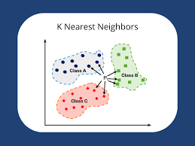
KNN
Our initial approach to identify fraudulent transactions was using K-Nearest Neighbors (KNN) algorithm
Our team thought KNN was a good choice for credit card fraud detection because it can identify patterns in the data that might not be immediately apparent.
Evaluated performance using various classification metrics to determine the effectiveness of our model in identifying fraudulent transactions.
Notes:
Our first approach to identify fraudulent transactions was to use the K-Nearest Neighbors (KNN) algorithm.
Our team thought KNN would be a good choice because it can identify patterns in the data that might not be immediately apparent and can handle large datasets with high-dimensional data with many features. Also an efficient algorithm and provides a good starting point for identifying fraudulent transactions in the dataset
We used the KNeighborsClassifier() function to create a KNN classifier, which we fit to the training data using the fit() function.
We predicted the labels of the test data using the predict() function, and evaluated the performance of the model using various classification metrics such as accuracy, precision, recall, F1 score, and confusion matrix.

Slide 6
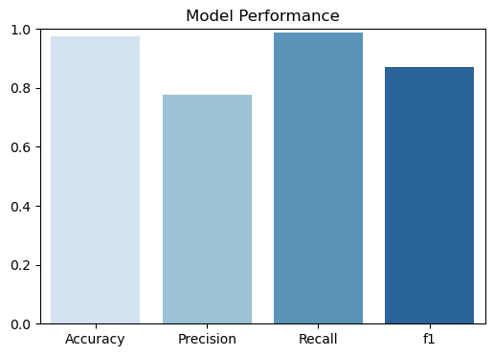
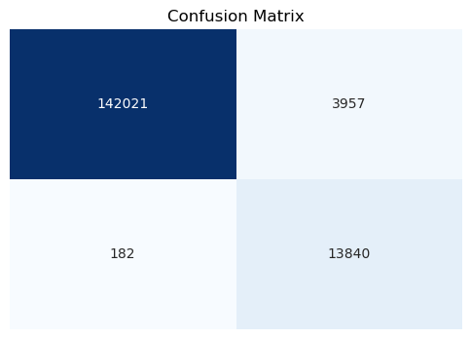
Evaluation of KNN
Accuracy score of 0.974
The precision score of 0.778
Recall score of 0.987
F1 score of 0.870
The confusion matrix shows 3,957 false positives, but only 182 false negatives, indicating that most fraudulent transactions were correctly identified.
Notes:
Accuracy score of 0.974, indicating that it can correctly identify 97.4% of the transactions.
The precision score of 0.778 suggests that out of all the transactions predicted as fraudulent, only 77.8% were actually fraudulent,
The recall score of 0.987 indicates that the model was able to correctly identify 98.7% of all actual fraudulent transactions.
The F1 score of 0.870, which is a weighted average of precision and recall, suggests that the overall performance of the model is good. The confusion matrix shows 3,957 false positives, but only 182 false negatives, indicating that most fraudulent transactions were correctly identified.

Slide 7
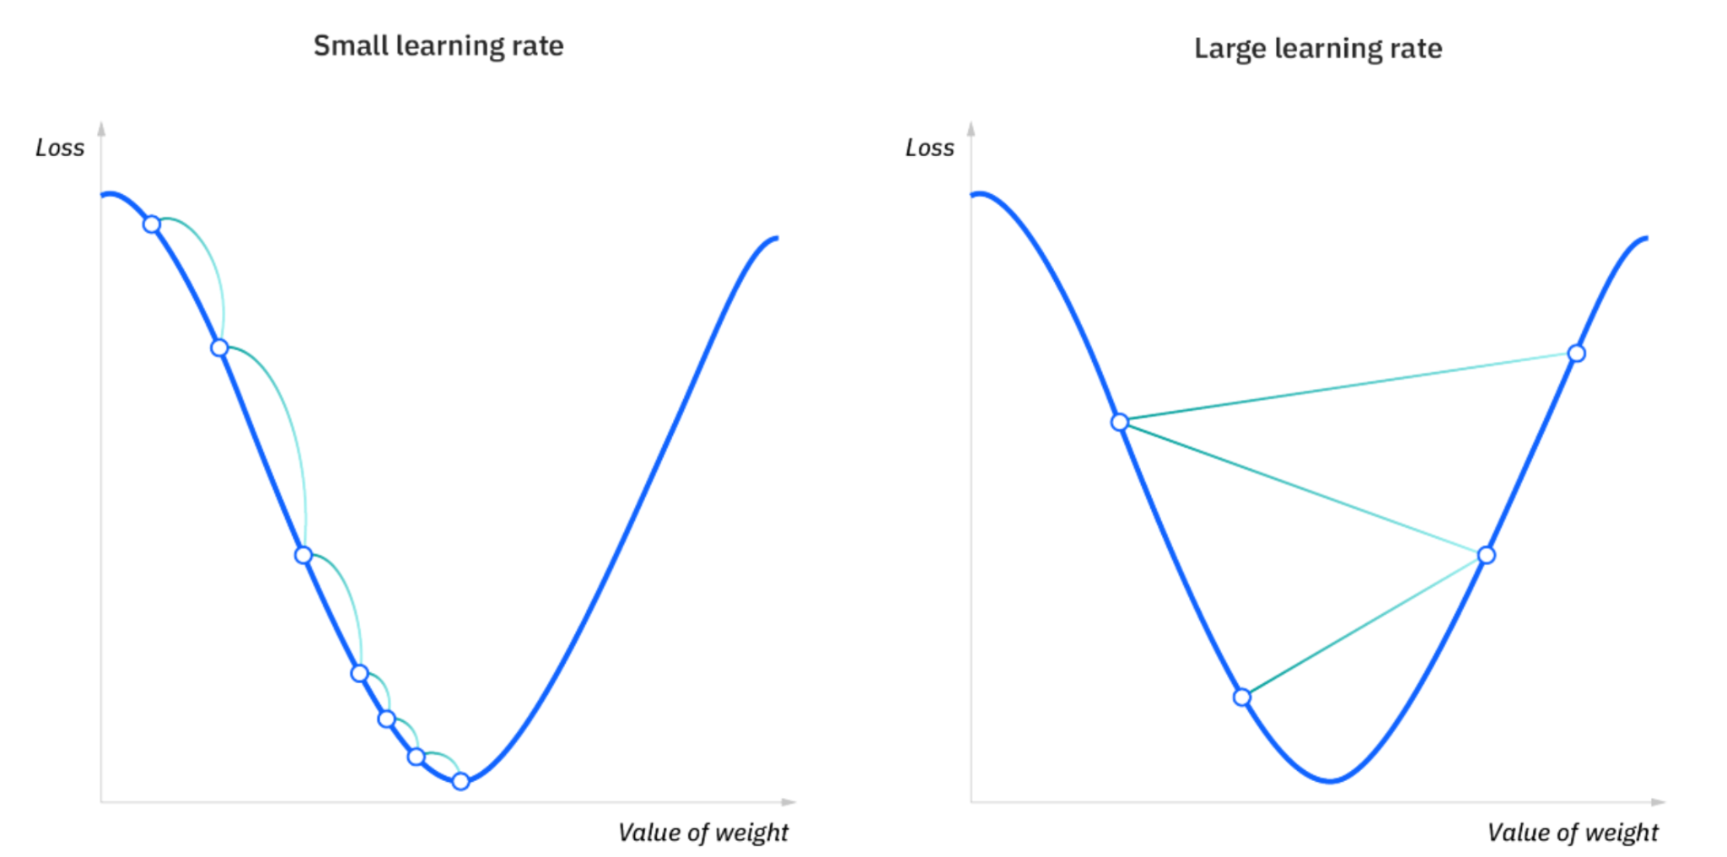
Gradient Descent
Notes:
Sources: https://www.ibm.com/topics/gradient-descent

Slide 8
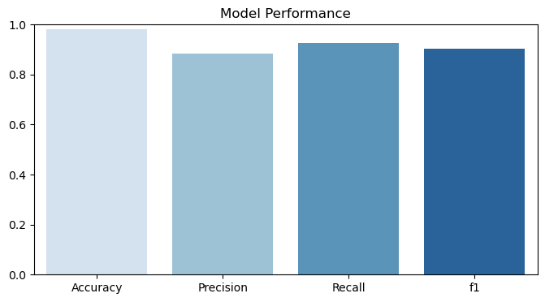
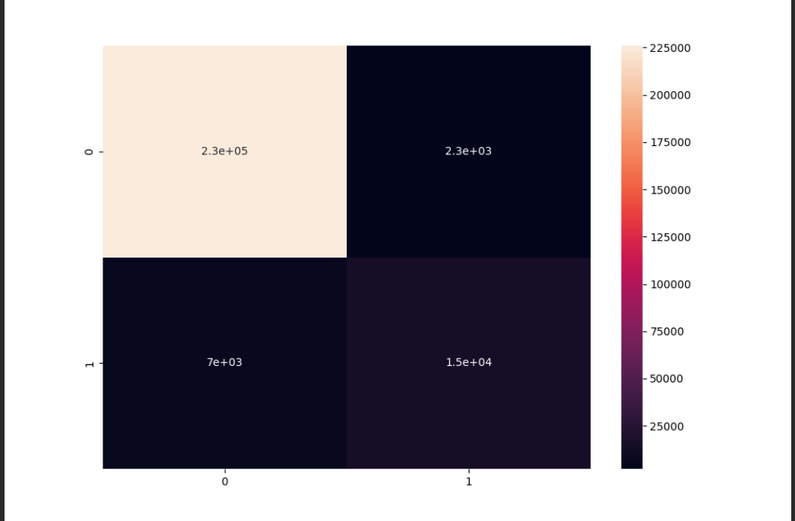
Evaluation of Gradient Descent
Notes:
Mention the specific type sof gradient descent models(?)
Precision: 0.8823758773069924
Recall: 0.6228655589819119
Accurcay: 0.960104
[[226412 1861]
[ 8113 13614]]

Slide 9
Decision Tree
Created a decision tree classifier
Fitted the model
Predicted the labels of the test data
Plotted the tree
Evaluated the performance of the model using accuracy, precision, recall, and F1 score

Slide 10
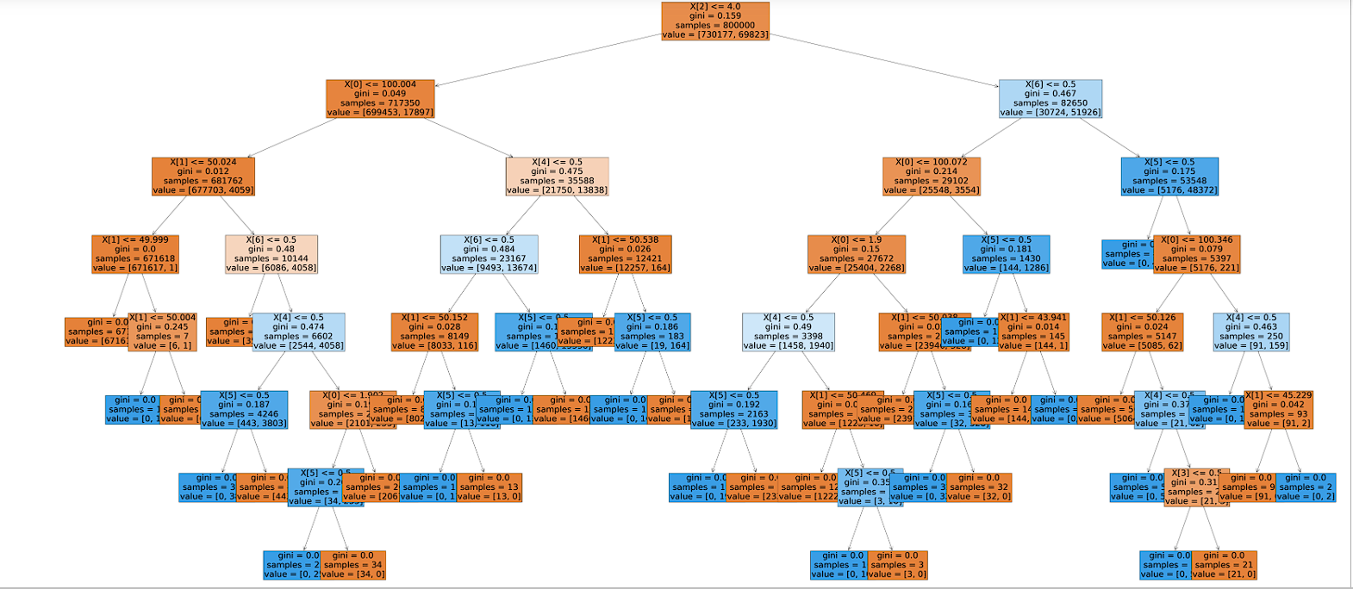
Decision Tree

Slide 11
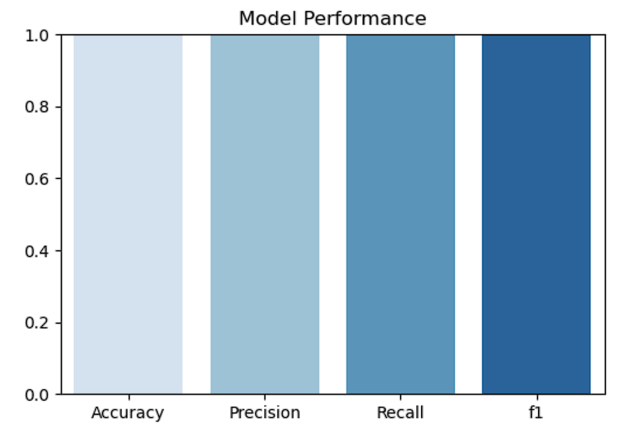
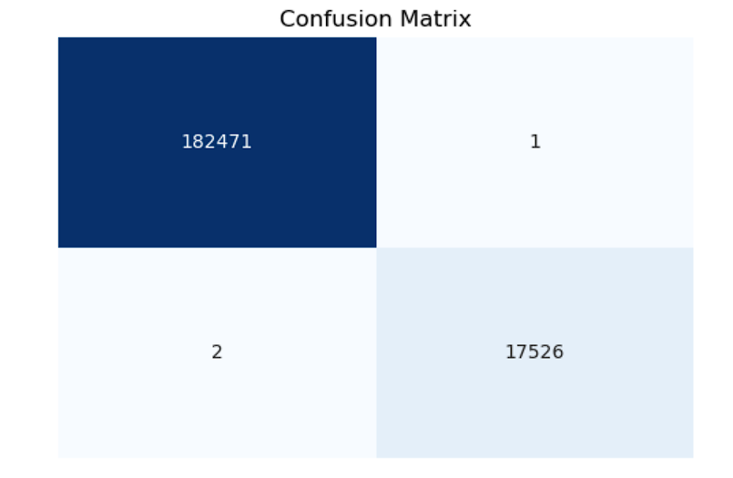
Evaluation of Decision Tree Classifier

Slide 12
Summary of Results
metrics | Decision Tree | KNN | Gradient Descent
Accuracy | 0.9999 | 0.9741 | 0.9638
Precision | 0.9998 | 0.7777 | 0.8705
Recall | 0.9996 | 0.987 | 0.6855
F1 score | 0.9997 | 0.8699 | 0.767

Slide 13
Conclusion
Preprocessing techniques such as using SMOTE and data cleaning for balancing the data and splitting the data into training, validation.
We determined the Decision Tree model was the best at predicting fraud - 0.9999 Accuracy.
In the future, we could look at ensuring the decision tree is not overfitting, possibly using extra data in a Validation, as well as using a stochastic gradient descent.
There is potential in other models we used, K-Nearest-Neighbors (KNN) and more.

Slide 14
https://docs.google.com/document/d/15E4UhE76_B0jqOGb3GWJbhLXz1U0QgDCzEFKcVotYeA/edit
Final Report document

